Slide 1
Introduction to policies, policy languages and ODRL
Víctor Rodríguez Doncel
Ontology Engineering Group. Universidad Politécnica de Madrid
Tutorial: Policy Evaluation and Enforcement on the Web with ODRL
Co-located with 23rd European Semantic Web Conference (ESWC)
May 10 2026 Dubrovnik , Croatia
Please do not distribute these slides without Victor's permission

Slide 2
What is a policy

Slide 3
A policy is the formal, perlocutionary expression of a will, which can be formal or not
Notes:
Jakobson would call appeal as Conative

Slide 4
Policy as an act of communication
Bühler's Organon Model (1934) in linguistics
Categories on acts of communication
Expression. Speaker reveals inner state. No truth value.
"I like Croatia"
Representation. Describes a fact about the world. True or false.
"I am in Croatia"
Appeal (conative). Directs the listener to act. No truth value
"Do not enter Croatia"
Notes:
Jakobson would call appeal as Conative

Slide 5

I want
Caspar David Friedrich, Der Wanderer über dem Nebelmeer, 1818

Slide 6
Usually, a perlocutionary act
Austin's original formulation (from How to Do Things with Words, 1962)
Locutionary act. the act of saying something with meaning.
("I wished hackers would not steal my data.")
Illocutionary act. the act performed in saying it.
(warning, promising, asserting, requesting, etc.)
Perlocutionary act. the effect produced on the listener
(persuading them, alarming them, getting them to act).
Austin (1962) How to Do Things with Words.
Notes:
acts of speech

Slide 7
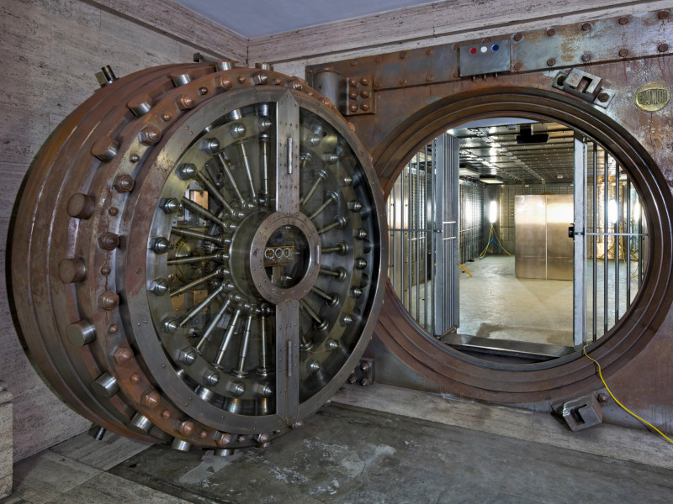

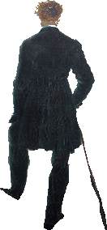
..and I can
...either I have the technical means
...or I have a legal protection
Perlocutionary acts produce an effect

Slide 8
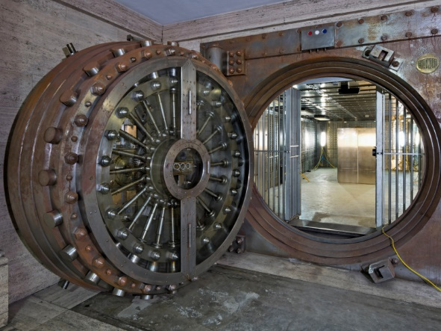
A policy is a perlocutionary act
This expression may be interpreted by a computer enforcing my policy
I want X
This expression triggers legal consequences
This is a policy
Policy: the perlocutionary expression of a will

Slide 9
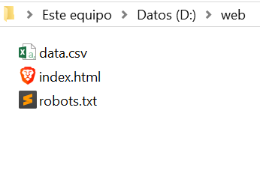
Policy with legal value
http://mydomain.com/robots.txt
# robots.txt – Reservation of rights for TDM (DSM Directive, Art. 4) User-agent: * Disallow: / # EXPRESS RESERVATION OF RIGHTS (redundant) # Specific AI / data mining crawlers User-agent: GPTBot Disallow: /
Notes:
Under Directive (EU) 2019/790 (Art. 4), Text and Data Mining is permitted by default, unless the rightholder expressly reserves their rights;
A machine-readable signal such as robots.txt constitutes such a reservation, thereby removing the exception and subjecting TDM to the underlying exclusive rights (e.g. copyright or database rights).

Slide 10
Policy with legal value
Under Directive (EU) 2019/790 (Art. 4), Text and Data Mining is permitted by default, unless the rightholder expressly reserves their rights;
A policy removes the exception
Notes:
Under Directive (EU) 2019/790 (Art. 4), Text and Data Mining is permitted by default, unless the rightholder expressly reserves their rights;
A machine-readable signal such as robots.txt constitutes such a reservation, thereby removing the exception and subjecting TDM to the underlying exclusive rights (e.g. copyright or database rights).

Slide 11
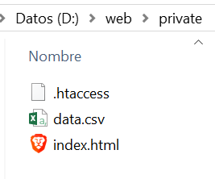
Policy with technical force
http://mydomain.com/private/.htaccess
# .htaccess – Access restriction policy
# Deny all HTTP access to this directory
Require all denied
# Optional: explicit legal notice (for evidential purposes)
<IfModule mod_headers.c>
Header set X-Policy-Notice "Access to this resource is restricted."
</IfModule>
Notes:
a crawler can ignore my policy

Slide 12
Policy with technical force
Server-level configuration files (e.g. .htaccess in Apache HTTP Server) implement access control policies that enforces the webmaster's will.
Side note: Incidentally, it also express a clear prohibition of access, which additional legal value: under copyright law, the circumvention or violation of a technological protection measure (TPM) is independently unlawful, regardless of whether access would otherwise be permitted under copyright exceptions.
Notes:
Under Directive (EU) 2019/790 (Art. 4), Text and Data Mining is permitted by default, unless the rightholder expressly reserves their rights;
A machine-readable signal such as robots.txt constitutes such a reservation, thereby removing the exception and subjecting TDM to the underlying exclusive rights (e.g. copyright or database rights).

Slide 13

The expression is a policy
# .htaccess – Access restriction policy
# Deny all HTTP access to this directory
Require all denied
# Optional: explicit legal notice (for evidential purposes)
<IfModule mod_headers.c>
Header set X-Policy-Notice "Access to this resource is restricted."
</IfModule>
I want X
we call this policy an enforceable policy
# robots.txt – Reservation of rights for TDM (DSM Directive, Art. 4) User-agent: * Disallow: / # EXPRESS RESERVATION OF RIGHTS (redundant) # Specific AI / data mining crawlers User-agent: GPTBot Disallow: /

Slide 14
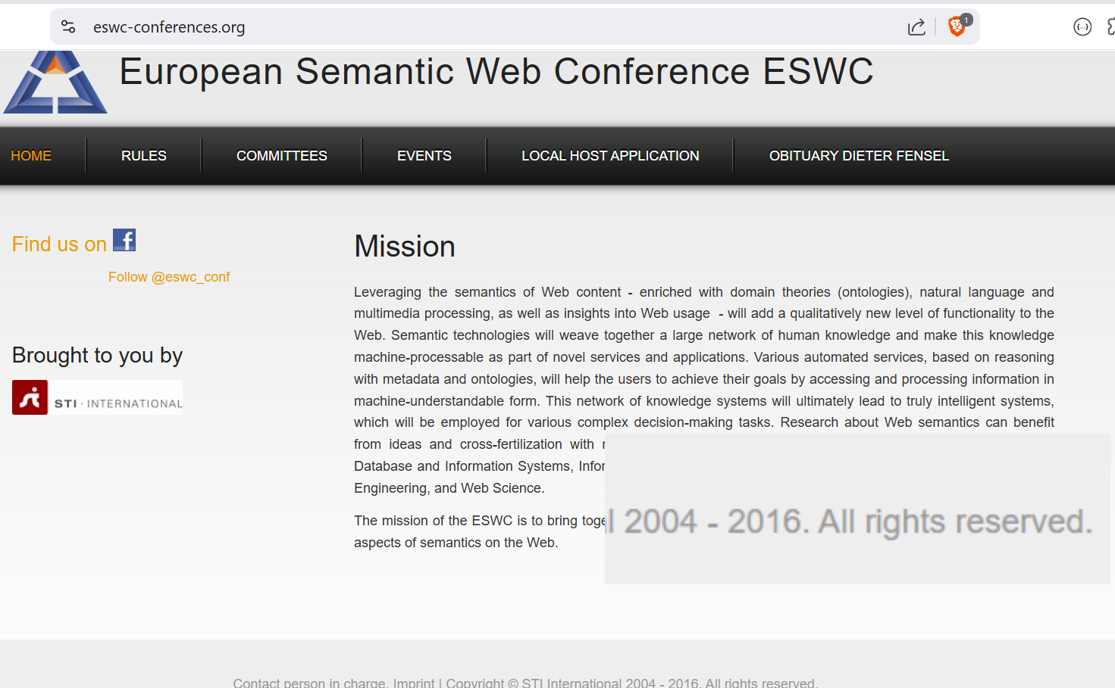
👉Question
Is this message enforceable? "Please do not copy the contents of this web"

Slide 15
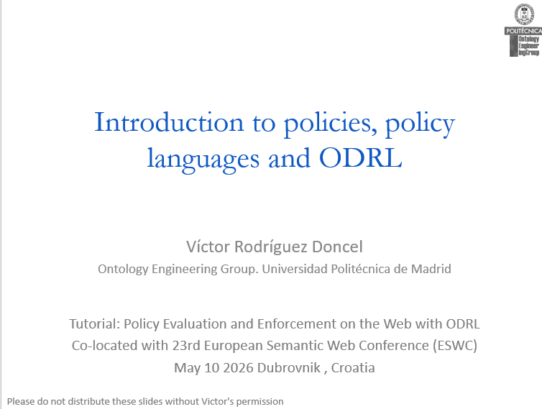
👉Question
Is it enforceable?
Please do not distribute these slides without Victor's permission

Slide 16
👉Exercise
Retrieve a robots.txt file
Visit some of your favourite's domains
ex. https://2026.eswc-conferences.org/robots.txt
RFC 9309 Robots Exclusion Protocol

Slide 17
Policies

Slide 18
Policy languages
robots.txt (1994)
Robots Exclusion Protocol; the earliest widely-deployed web policy mechanism, letting sites declare which paths crawlers may or may not access. Originally an informal convention by Martijn Koster, formally standardized as IETF RFC 9309 in 2022.
Ponder (2001)
Object-oriented policy language for distributed systems management; foundational in academic policy research.
ODRL (2002)
Open Digital Rights Language; expresses permissions, prohibitions, and duties over digital content. Became a W3C Recommendation in 2018.
SAML (2002)
Security Assertion Markup Language; XML-based standard for exchanging authentication and authorization assertions (SSO). 2.0 released in 2005.
P3P (2002)
Platform for Privacy Preferences; early W3C standard for machine-readable website privacy practices. Now deprecated but historically influential.
XACML (2003)
eXtensible Access Control Markup Language; OASIS standard and de-facto language for attribute-based access control (ABAC).

Slide 19
Policy languages
EPAL (2003)
Enterprise Privacy Authorization Language; IBM-originated language for fine-grained enterprise privacy policies.
MPEG-21 REL (2004)
Rights Expression Language standardized as ISO/IEC 21000-5; XrML-based language for declaring rights over multimedia content.
Rego (2016)
Declarative language behind Open Policy Agent (OPA); widely adopted for cloud-native authorization (Kubernetes, microservices, CI/CD).
ODRL 2.2 (2018)
Current W3C Recommendation; defines the Information Model and Vocabulary & Expression, supporting richer constraints, duties, and a formal RDF/JSON-LD serialization for interoperable rights expressions on the web.
Cedar (2023)
Open-source policy language from AWS; combines RBAC and ABAC with formal verification of policy correctness.

Slide 20
Policies with a formal sytanx

Slide 21
Enforceable policies must be written in a formal language
Notes:
Jakobson would call appeal as Conative

Slide 22
Formal systems (recalling logic)
A formal system has three components:
Alphabet. a finite set of symbols. All expressions are built from these.
Axioms. a chosen set of strings taken as the starting points, accepted without derivation.
Transformation rules. rules that produce new strings from existing ones.
Strings in the system, out of the system
Starting from the axioms and applying the transformation rules, the system mechanically produces strings. A string belongs to the system if and only if it can be reached this way. No meaning is involved, only symbol manipulation.

Slide 23
An informal example of a formal system The rules of a game: M,I,U
It consists of forming sequences of characters
Rules
There are only three possible characters: M, I, U
Axioms
RF1: MI is a formula in the system
Transformation Rules
RT1: Add a U to the end of any sequence ending in I
Example: Going from MIUUI to MIUUIU
RT2: Duplicate any sequence after an M
Example: Moving from MIU to MIUIU
RT3: Replace any III sequence with a U.
Example: from MUIIIU to MUUU
RT4: Eliminar cualquier UU.
Ejemplo: pasar de MUUU a MU

Slide 24

Example
Game: you must arrive at MIU. You will have proved it is a theorem in the system.
Douglas Hofstadter, 1979, «Gödel, Escher, Bach»
Notes:
You can never arrive into MU, or U.

Slide 25
Example
Game: you must arrive at MIU
To get to MIU, the following steps can be taken
MI (RF1)
MII (from 1, RT2)
MIIII (from 2, RT2)
MIU (from 3, RT3)
We have derived MIU.
MIU is a theorem in this formal system.
Can you derive now MIUU?
Can you derive MU?
Douglas Hofstadter, 1979, «Gödel, Escher, Bach»
Notes:
You can never arrive into MU, or U.?
MIUU: RF1, RT2, RT2, RT1, RT3

Slide 26
Examples
Strings of
characters
MIKK
Well formed formulas
MU
Theorems
MIU

Slide 27

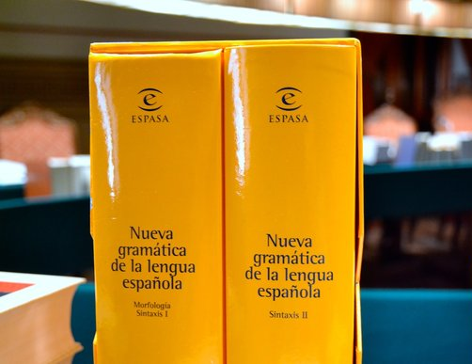
Were our policies formal?
Natural languages are not formal languages
Still, there are (flexible) syntaxes
Do not distribute the slides without Victor's permission
I eat policies (even if it is meaningless, this is syntactically ok)
The slides without Victor's permission do not distribute

Slide 28
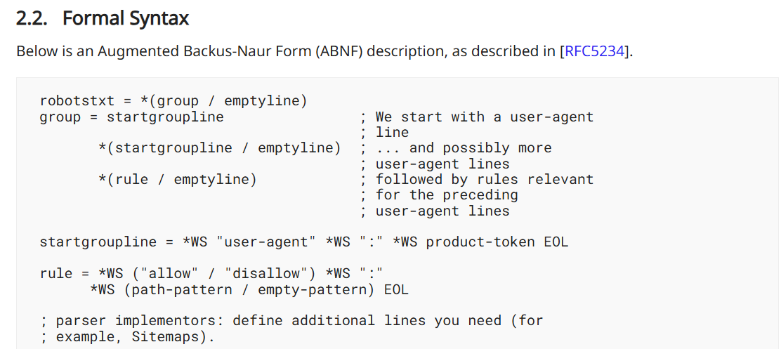
Syntax of robots.txt
(The robots.txt has a formal syntax)
EBNF (Extended Backus–Naur Form) is a notation for formally describing the syntax of programming languages and grammars in a precise, readable way.
RFC 9309 Robots Exclusion Protocol
Notes:
the rules are expressed in a grammar

Slide 29
Check the syntax of a robots.txt
robotstxt = *(group / emptyline)
group = startgroupline ; We start with a user-agent
; line
*(startgroupline / emptyline) ; ... and possibly more
; user-agent lines
*(rule / emptyline) ; followed by rules relevant
; for the preceding
; user-agent lines
startgroupline = *WS "user-agent" *WS ":" *WS product-token EOL
rule = *WS ("allow" / "disallow") *WS ":"
*WS (path-pattern / empty-pattern) EOL
; parser implementors: define additional lines you need (for
; example, Sitemaps).
product-token = identifier / "*"
path-pattern = "/" *UTF8-char-noctl ; valid URI path pattern
empty-pattern = *WS
identifier = 1*(%x2D / %x41-5A / %x5F / %x61-7A)
comment = "#" *(UTF8-char-noctl / WS / "#")
emptyline = EOL
EOL = *WS [comment] NL ; end-of-line may have
; optional trailing comment
NL = %x0D / %x0A / %x0D.0A
WS = %x20 / %x09
; UTF8 derived from RFC 3629, but excluding control characters
UTF8-char-noctl = UTF8-1-noctl / UTF8-2 / UTF8-3 / UTF8-4
UTF8-1-noctl = %x21 / %x22 / %x24-7F ; excluding control, space, "#"
UTF8-2 = %xC2-DF UTF8-tail
UTF8-3 = %xE0 %xA0-BF UTF8-tail / %xE1-EC 2UTF8-tail /
%xED %x80-9F UTF8-tail / %xEE-EF 2UTF8-tail
UTF8-4 = %xF0 %x90-BF 2UTF8-tail / %xF1-F3 3UTF8-tail /
%xF4 %x80-8F 2UTF8-tail
UTF8-tail = %x80-BF
This is all the robots.txt grammar!
https://www.rfc-editor.org/rfc/rfc9309

Slide 30
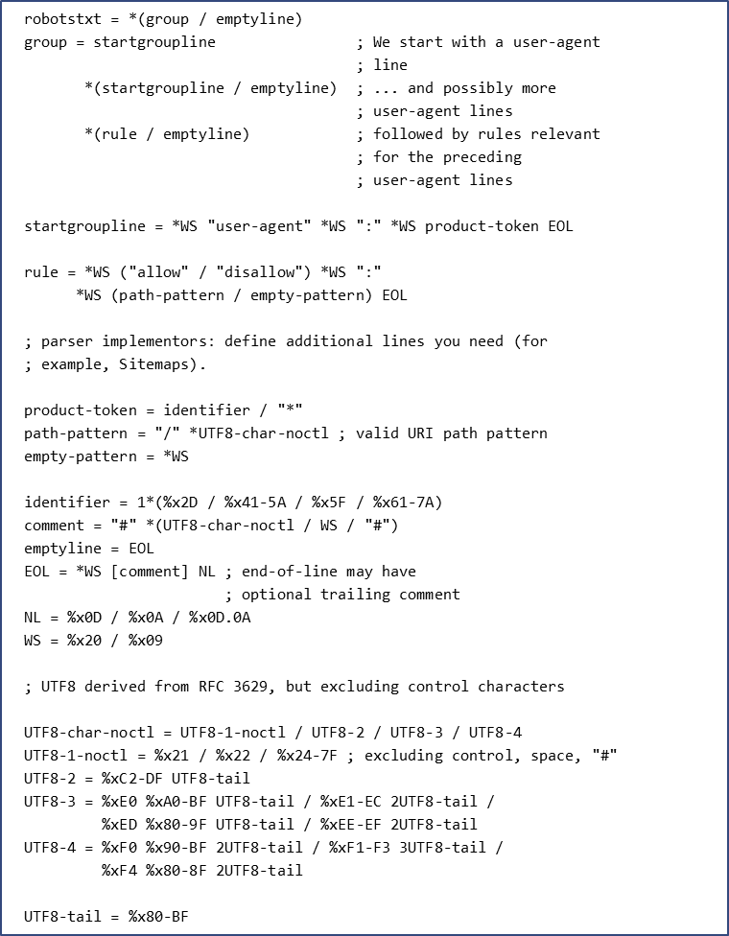
Check the syntax of a robots.txt
PARSER
yes/no
grammar.abnf
User-agent: *
Allow: /
robots.txt
https://www.rfc-editor.org/rfc/rfc9309

Slide 31
Check the syntax of a robots.txt
cd d:\tutorial\e1
python validate.py
https://github.com/vroddon/policiestutorial

Slide 32
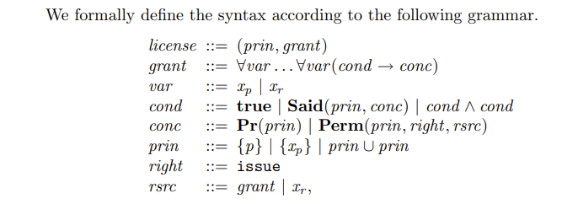
MPEG-21 REL Syntax
Joseph Y. Halpern and Vicky Weissman. “A Formal Foundation for XrML.” Journal of the ACM (JACM), vol. 55, no. 1, 2008

Slide 33
Check the syntax of MPEG-21 REL
cd d:\tutorial\e2
python validate.py

Slide 34
Check the RDFS/OWL consistency of an ODRL policy
cd d:\tutorial\e3
python validate.py policy.ttl ODRL22.ttl

Slide 35
Normalisation
Different ODRL policies may convey the same information
Normalisation transforms a policy into another equivalent, but in a normal form
Example of normalisation:
N1. Internalisation of parties and assets declared out of the policy.
N2. Type declaration of policy elements. This transformation infers class types for Policy, Set, Permission, Duty, Constraint, and LogicalConstraint based on the ODRL Ontology and Information Model 2.1 rules..
...
Up to 10 were defined
Notes:
he ODRL model permits
two ways of linking parties or assets with policies. This transformation maps external refer-
ences to Policy, Assignee, or Assigner using odrl:hasPolicy, odrl:assignerOf, and
odrl:assigneeOf, generating new RDF triples with odrl:target, odrl:assigner,
and odrl:assignee while preserving multiple instances of these entities.

Slide 36
Validation rules
Some examples
V2. Every policy must have at least one rule
V3. Every policy must be identified by a URI
V8. No remedy can refer to a duty that includes a consequence duty
V9. Every AssetCollection with a refinement must have a source
V16. Every constraint must have exactly one right operand
...
Every validation had a SHACL shape

Slide 37
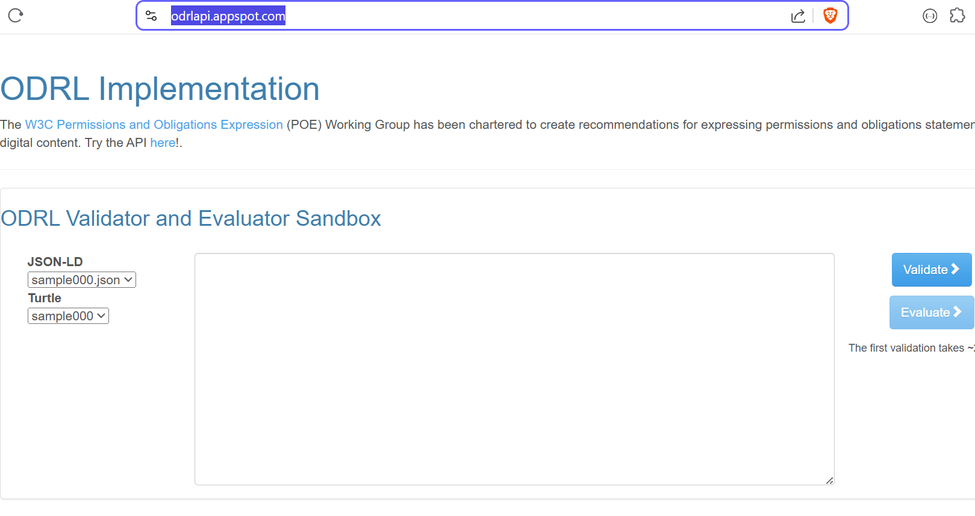
Check the ODRL policy syntactic validity
https://odrlapi.appspot.com/
Based on SHACL

Slide 38
Policies with formal semantics

Slide 39
Enforceable policies must have formal semantics
Notes:
Jakobson would call appeal as Conative

Slide 40
Syntax vs Semantics
Two generalist definitions from Wikipedia:
Syntax: part of grammar that studies the rules that govern the combinatorics of syntactic constituents and the formation of units greater than these
Semantics: The term semantics (of Greek origin: «lo que tiene significado») refers to the aspects of the meaning, sense or interpretation of linguistic signs such as symbols, words, expressions or formal representations.
Notes:
Recuerda el “análisis morfo sintáctico”.

Slide 41
Syntax and semantics
Another invented formal language:
Alphabet of primitive symbols: {p,r,c,a,r,d,P,T,C,A,R,D,-}
Syntactic rules that indicate whether a sequence is legal
A1: Each sequence consists of exactly 64 consecutive signs
A2: Once and only once do the symbols "r", "R" appear
A3: Symbols {p,P} cannot appear in either the first 8 or the last 8 positions
Examples of well-formed formulas:
tcadractpppppppp--------------------------------PPPPPPPPTCADRACT
-r--R-----------------------------------------------------------

Slide 42
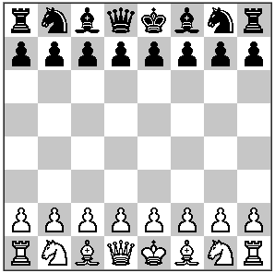
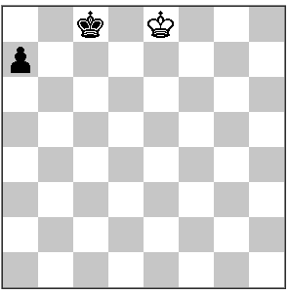
Syntax and semantics
Examples of well-formed formulas:
tcadractpppppppp--------------------------------PPPPPPPPTCADRACT
--r-R---p-------------------------------------------------------

Slide 43
Semantics is about interpretation
tcadractpppppppp--------------------------------PPPPPPPPTCADRACT
interpretation

Slide 44
Example: interpretation in propositional logic
interpretation
wff
TRUE
OR FALSE
Interpreting a formula in propositional logic means attributing to it a truth value
Interpreatation as function from wff_{A} to {true,false}

Slide 45
Example: interpretation in policies for access control
interpretation
wff
ACCESS
or NOT ACCESS
Interpreting a policy for access control
Interpreatation as function from wff_{A} to {access,not access}

Slide 46
Truth tables
The formal version says I(F), "interpretation of F"
Notes:
Si la interpretación de F es… y la interpretación de G es…
Una vez que las variables han sido interpretadas, y las conectivas definidas, las fórmulas moleculares pueden ser interpretadas:

Slide 47
Types of access control
Access control lists
Access control lists are the oldest and most basic form of access control. Set of users and operations that can be performed on a resource as a mapping.
Role-based Access Control (RBAC)
restrict access to authorized users based on their role. The roles define the resources that can be accessed by users assigned to that role
Attribute-based access control (ABAC)
access rights are granted to users through the use of policies that combine attributes together.
Policy-based Access Control
access is based on unambiguous policies using authorized attribute sources in the enterprise
Notes:
Access Control Lists. Access control lists are the oldest and most basic form of access control. This type was primarily adopted for use in operating systems. This maintains a set of users and operations that can be performed on a resource as a mapping. This is easy to implement due to the use of maps. However, this is not scalable for larger user bases and can become difficult to manage.
Role-based Access Control (RBAC) is an approach used to restrict access to authorized users based on their role. This is a static permission model which provides access control. This access control type is used when all users are categorized into different roles. The roles define the resources that can be accessed by users assigned to that role. This type of access control reduces management overhead. These users and roles can also be externalized using user stores. These roles need to be managed carefully. There can be instances where a user is assigned to multiple roles. This is a subset of ABAC.
Attribute-based Access Control defines a new access control paradigm whereby access rights are granted to users through the use of policies that combine attributes together. Here, authorization happens based on attributes. This access control type addresses the limitations of role-based access control to provide a more fine-grained approach. This can be based on the attributes of the user, the environment, or even the resource itself. This is more flexible when compared with the role-based approach. There is no need to know the user prior to granting access.
Policy-based Access Control. This type of access control addresses the requirement to have a more uniform access control mechanism. This helps larger enterprises to have uniform access control for the large amount of organizational units. This is helpful when carrying out security audits. This is the most complex form of access control. This involves specifying policies unambiguously using XACML and using authorized attribute sources in the enterprise. Here Policy Based Access Control(PBAC) (also called Rule-based access control) is an extension of ABAC where attributes are used in writing policies.

Slide 48
Web Access Control
Web Access Control (WAC)
a authorization model for the web that defines who can read, write, or control resources using machine-readable access control lists.
in the W3C Solid ecosystem to give users fine-grained control.
Does it have syntax? does it have semantics?
@prefix acl: <http://www.w3.org/ns/auth/acl#>. @prefix foaf: <http://xmlns.com/foaf/0.1/>. <#authorization1> a acl:Authorization; acl:agent <https://alice.example/profile/card#me>; acl:accessTo <https://example.org/data/file1.txt>; acl:mode acl:Read, acl:Write.
https://solid.github.io/web-access-control-spec

Slide 49
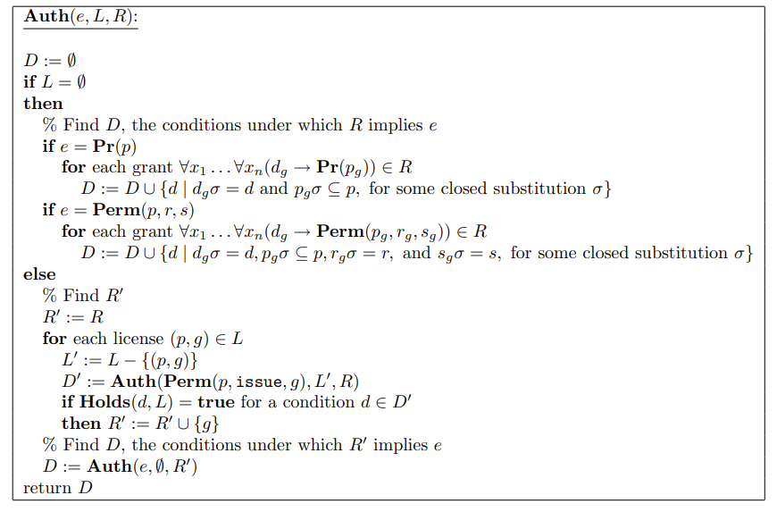
Semantics of MPEG-21 REL
Joseph Y. Halpern and Vicky Weissman. “A Formal Foundation for XrML.” Journal of the ACM (JACM), vol. 55, no. 1, 2008

Slide 50
XACML

Slide 51
XACML eXtensible Access Control Markup Language
OASIS policy specification (2003): A standard XML language to express who can do what on which resource, and a standard request/response protocol
Why it matters :
First standard policy language for access control
Introduced the clean PAP / PDP / PEP architectural separation that all modern authorisation systems still follow
Policies became declarative and portable: write once, enforce anywhere
Directly influenced later standards and frameworks

Slide 52
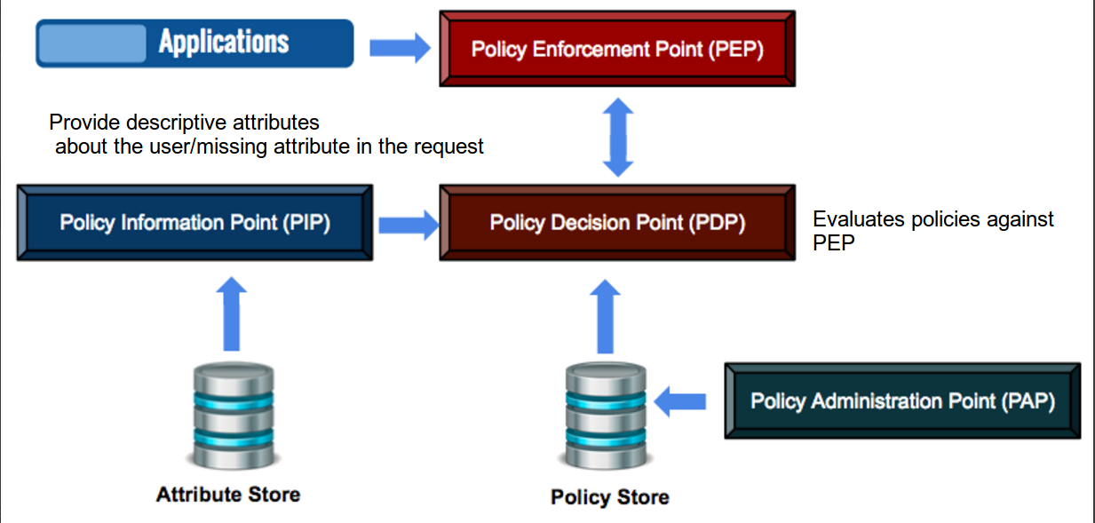
XACML architecture

Slide 53
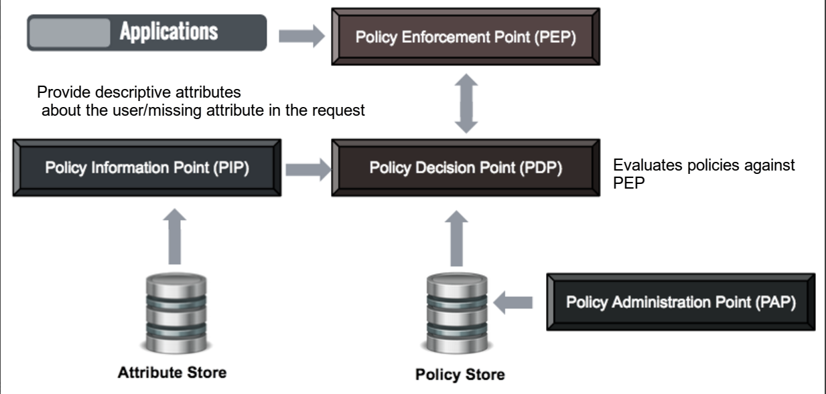
XACML architecture
Enforces
Manage policies
Provides information
Decides

Slide 54
XACML architecture
ODRL Only covers this!

Slide 55
XACML Architecture
Policy Enforcement Point (PEP) :
The system entity that performs access control by making decision requests and enforcing authorization decisions. It sends the XACML request to the Policy Decision Point (PDP).
Policy Decision Point (PDP) :
The entity that evaluates an applicable policy and returns an authorization decision.
Policy Information Point (PIP) :
The entity that acts as a source of attribute values. If there are missing attributes in the XACML request that is sent by PEP, PIP would find them for the PDP to evaluate the policy.
Policy Administration Point (PAP) :
The entity that creates a policy or policy set and manages them.

Slide 56
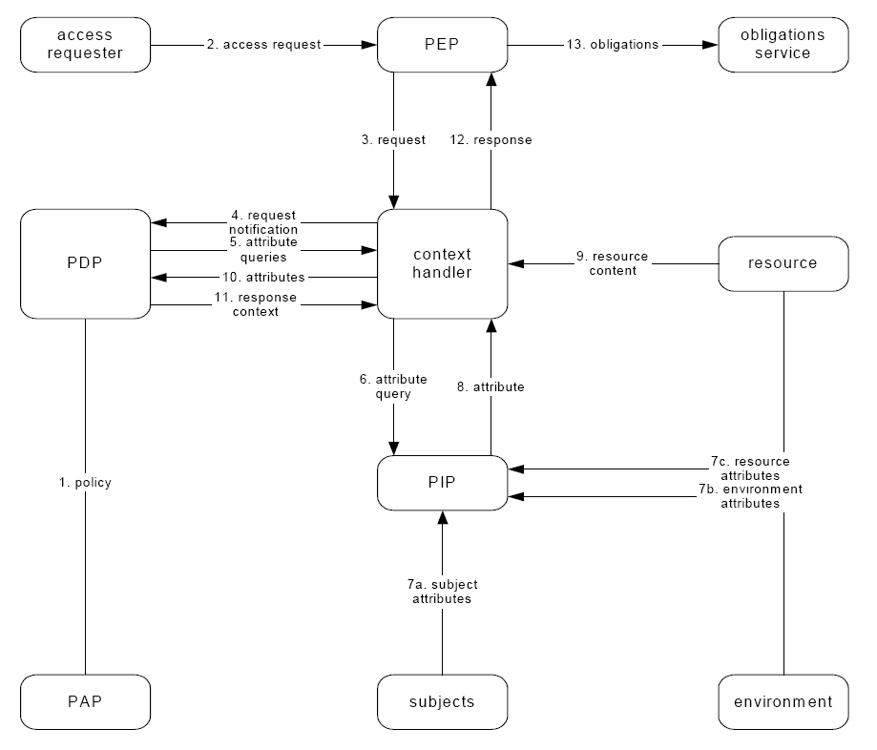
Usage scenario

Slide 57
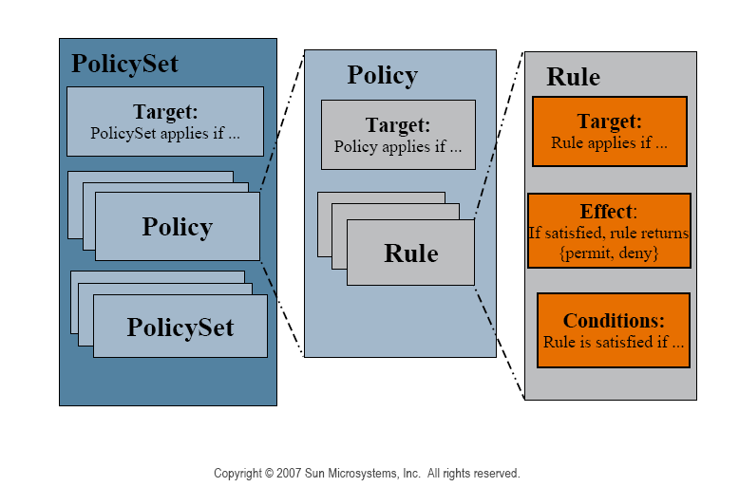
XACML Policy structure

Slide 58
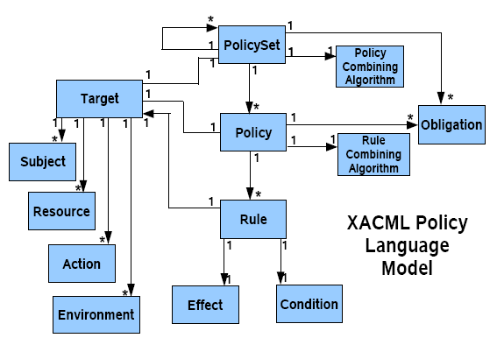
XACML Policy language model

Slide 59
XACML Request and response
Request
Subject
Attributes
Resource
Attributes
Action
Attributes
Environment
Attributes
Response
Decision
Status
Obligations

Slide 60
Combining algorithms
Deny-overrides –
if any evaluation returns Deny, then the result must be Deny.
If all rules evaluate to Permit, then the result is Permit.
Permit-overrides –
if any rule evaluates to Permit, then the result of is Permit.
If any rule evaluates to Deny and all other rules evaluate to NotApplicable, then the result is Deny.
If all rules are found to be NotApplicable, then the result is NotApplicable.

Slide 61
Test Sun's XACML implementation
Make a test!
curl -L "https://sourceforge.net/projects/sunxacml/files/sunxacml/Version%201.2/sunxacml-1.2.zip/download" -o sunxacml.zip
tar -xf sunxacml.zip
cd sunxacml-1.2
java -cp "lib/sunxacml.jar;lib/samples.jar" SimplePDP sample/request/door-access.xml sample/policy/time-range.xml

Slide 62
request-door.xml
<?xml version="1.0" encoding="UTF-8"?>
<Request xmlns="urn:oasis:names:tc:xacml:1.0:context"
xmlns:xsi="http://www.w3.org/2001/XMLSchema-instance">
<Subject>
<Attribute AttributeId="urn:oasis:names:tc:xacml:1.0:subject:subject-id"
DataType="urn:oasis:names:tc:xacml:1.0:data-type:rfc822Name">
<AttributeValue>seth@users.example.com</AttributeValue>
</Attribute>
</Subject>
<Resource>
<Attribute AttributeId="urn:oasis:names:tc:xacml:1.0:resource:resource-id"
DataType="http://www.w3.org/2001/XMLSchema#string">
<AttributeValue>main-door</AttributeValue>
</Attribute>
</Resource>
<Action>
<Attribute AttributeId="urn:oasis:names:tc:xacml:1.0:action:action-id"
DataType="http://www.w3.org/2001/XMLSchema#string">
<AttributeValue>open</AttributeValue>
</Attribute>
</Action>
</Request>
Can the user seth@users.example.com open the main-door?"

Slide 63
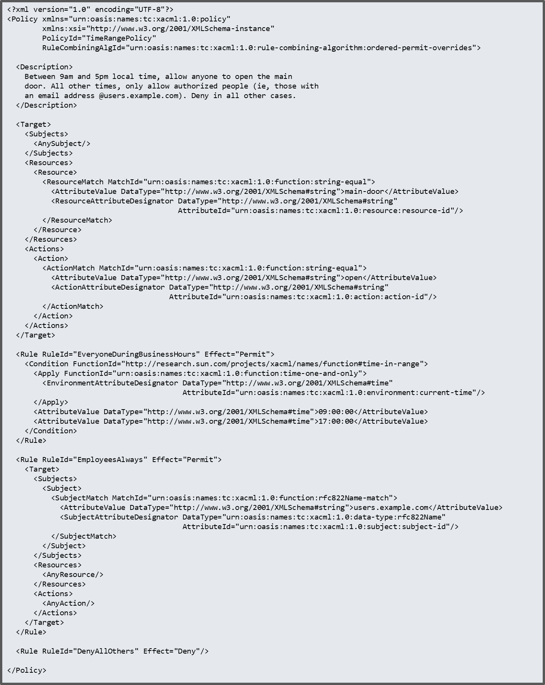
policy.xml
Between 9am and 5pm local time, allow anyone to open the main door. All other times, only allow authorized people (ie, those with an email address @[users.example.com](http://users.example.com)). Deny in all other cases.

Slide 64
Response
<Response>
<Result ResourceID="main-door">
<Decision>Permit</Decision>
<Status>
<StatusCode Value="urn:oasis:names:tc:xacml:1.0:status:ok"/>
</Status>
</Result>
</Response>
Yes! at any time.

Slide 65
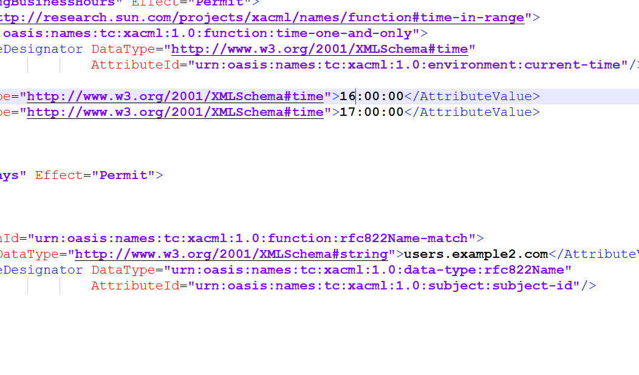
A second policy
We change the policy

Slide 66
Test Sun's XACML implementation
Make a second test!
00 java -cp "lib/sunxacml.jar;lib/samples.jar" SimplePDP sample/request/door-access.xml sample/policy/time-range.xml
<Response>
<Result ResourceID="main-door">
<Decision>Deny</Decision>
<Status>
<StatusCode Value="urn:oasis:names:tc:xacml:1.0:status:ok"/>
</Status>
</Result>
</Response>

Slide 67
XACML Conformance

Slide 68
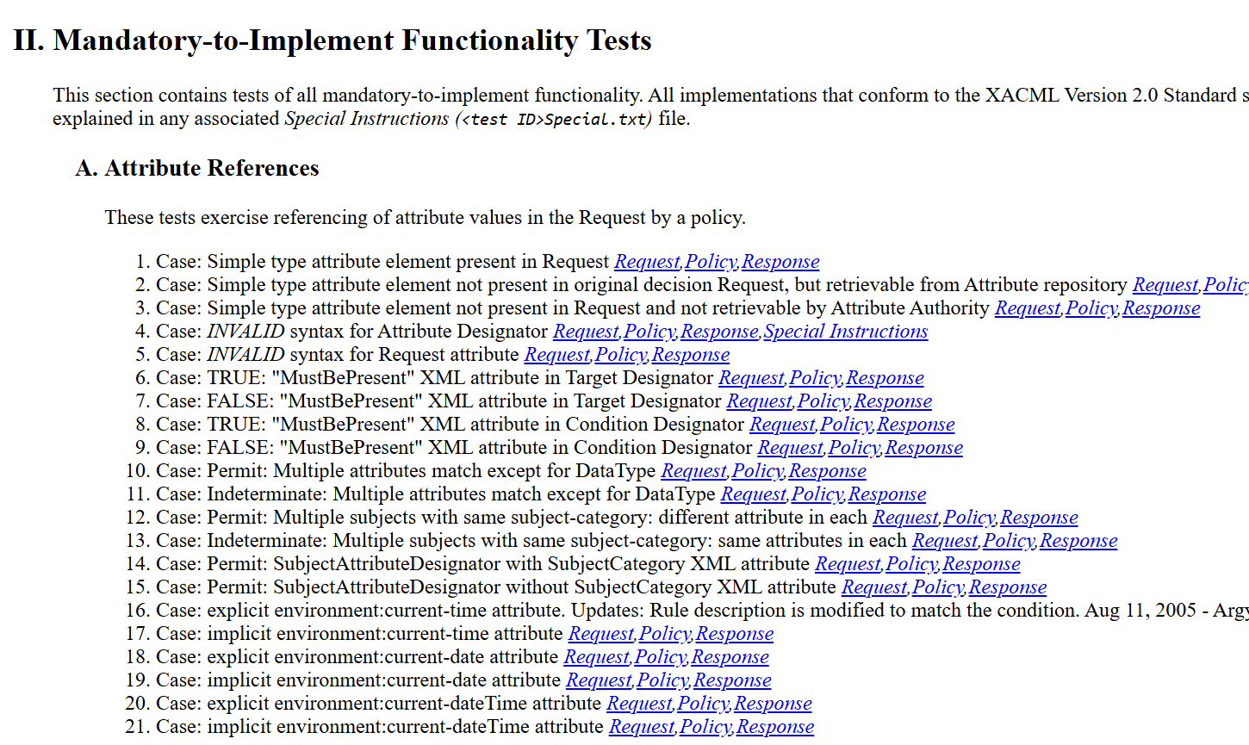
Conformance
Notes:
file:///C:/Users/victor/Desktop/sunxacml-2.0-M2-SNAPSHOT-tests/conformance-tests/ConformanceTests.html

Slide 69
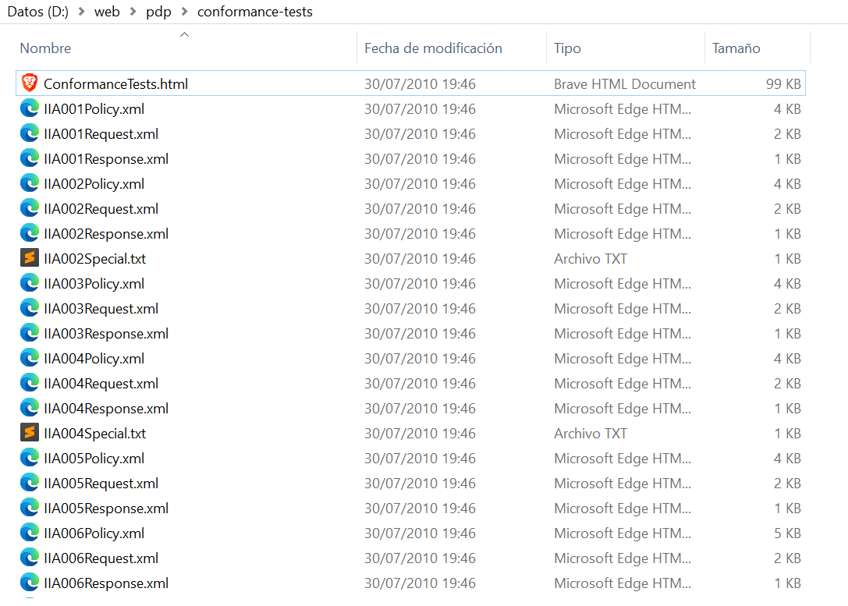
Conformance Tests

Slide 70
ODRL

Slide 71
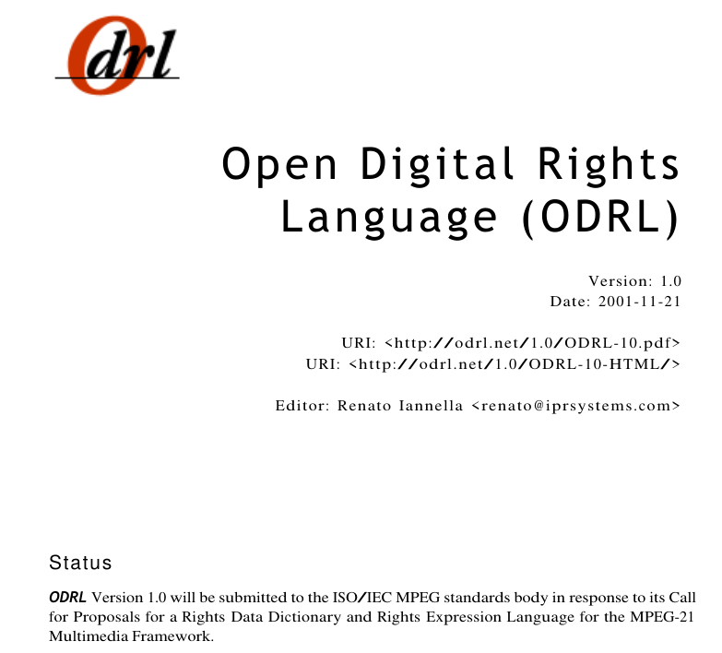

ODRL as an answer to a call
ISO/IEC 21000
MPEG-21

Slide 72
History of ODRL: The context of RELs
Rights Expression Languages (Circa 2000)
XrML (ContentGuard)
ODRL (Open group)
Standardisation
ISO/IEC 21000 (MPEG-21)
Part 5 Rights Expression Language (2004)
Part 6 Rights Data Dictionary (2004)
Part 19 Media Value Chain Ontology (2010)
Part 20 Contracts Expression Language (2013)
Part 21 Media Contracts Ontology
Part 23 Smart Contracts for Media (2022)
Others: IEEE/IMS Learning Content, OASIS, Open eBook Forum, OMA, Editeur ONIX Books, PRISM, PLUS Photo, Creative Commons (ccREL)
Notes:
ContentGuard's solution, Evolution

Slide 73




History of ODRL (2001-2011)
ODRL Initiative
https://odrl.net
2001 Jan W3C DRM Workshop
https://www.w3.org/2000/12/drm-ws/
2001 Nov ODRL 1.0
2002 Sep W3C Note ODRL V1.1
http://www.w3.org/TR/odrl/
ODRL Profiles
Creative Commons, Service-Oriented Computing
Dublin Core, Geospatial
Adopted by Open Mobile Alliance (OMA) - Part of DRM in Mobile handsets
ODRL V2 Requirements and Early Drafts of Version 2.0
Ten international ODRL workshops
2011.09.29-30 SeptVirtual Goods + ODRL Workshop, Barcelona, Spain
Adapted from R. Ianella
Notes:
https://www.w3.org/2012/09/odrl/archive/odrl.net/

Slide 74
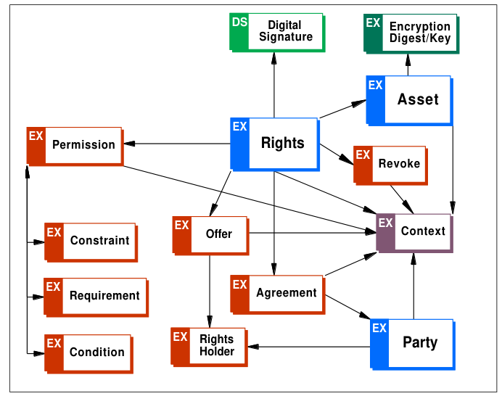
ODRL 1.0

Slide 75
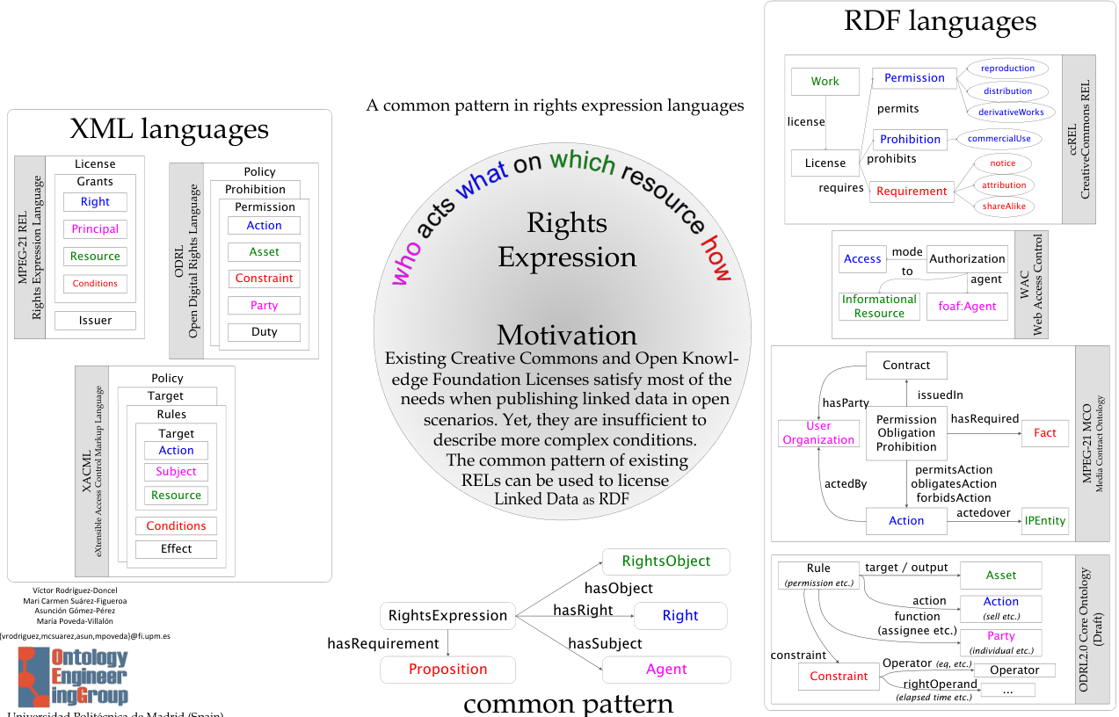
Common pattern

Slide 76
History of ODRL (2012 - 2016): ODRL W3C Community Group
W3C ODRL Community Group
https://www.w3.org/community/odrl/
53 participants
2014 May ODRL 2.0 W3C Community Group spec
Open Digital Rights Language (ODRL) Ontology (Mc Roberts, Rodríguez-Doncel)
JSON and Ontology encodings
2015 Mar ODRL 2.1 W3C Community Group spec
Legal review of all terms over 2.0
RightML Profile (International Press Telecommunications C.)
Open Digital Rights Language (ODRL) Ontology
Implementations (10+)
https://www.w3.org/community/odrl/implementations/

Slide 77
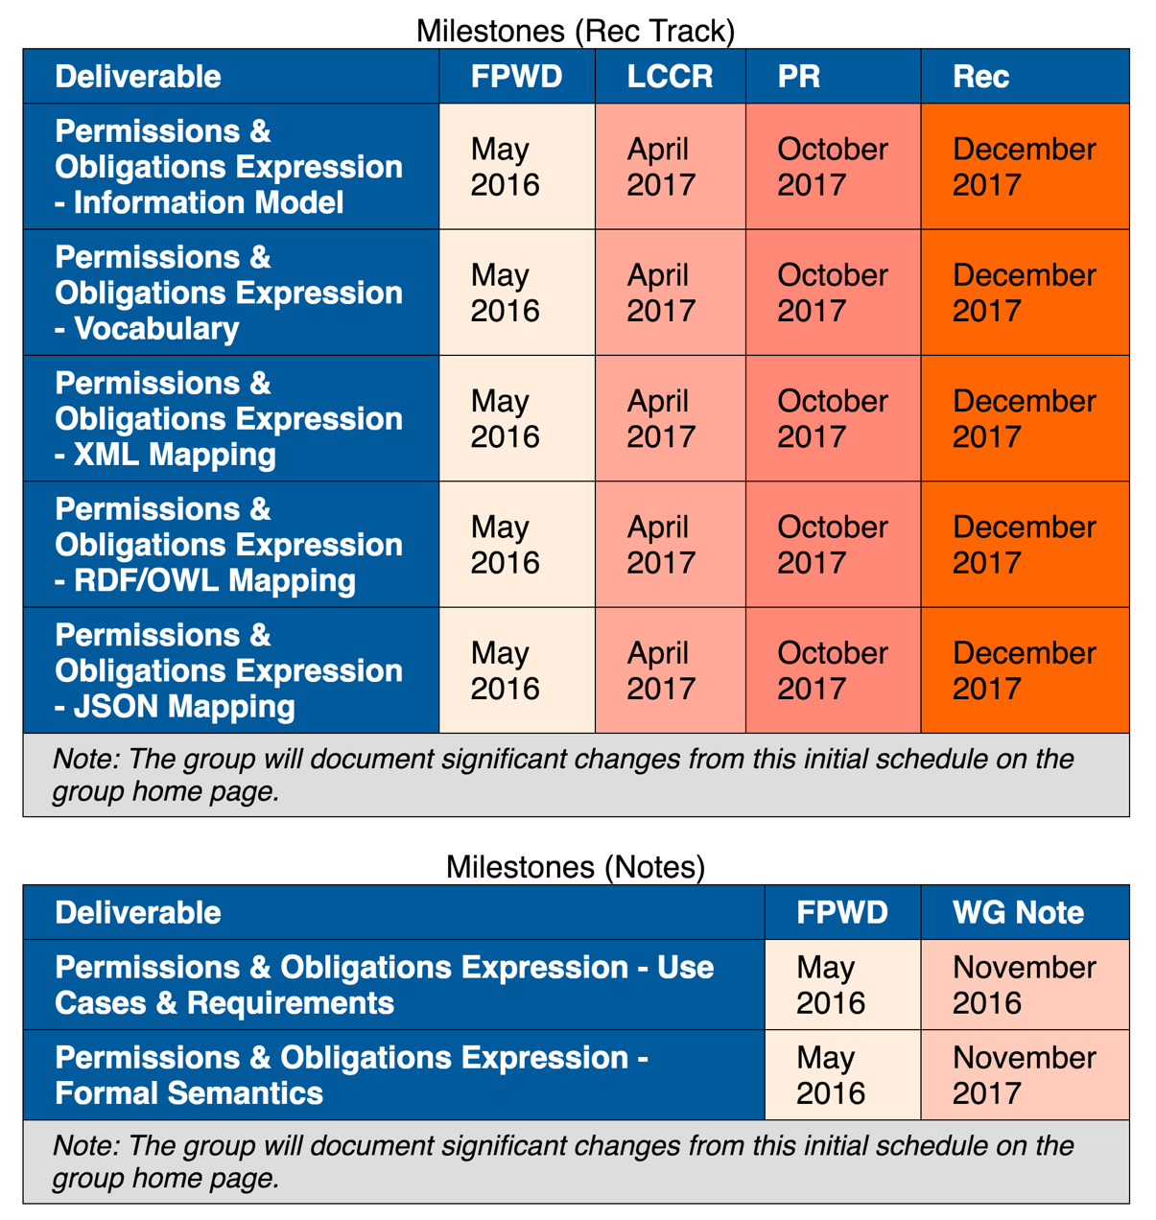
History of ODRL (2016 - 2018): W3C Permissions and Obligations Working Group
W3C Permissions and Obligations Working Group
https://www.w3.org/2016/poe/
22 Members + 3 Invited Experts
ODRL Community Group Specifications were the baseline for the TRs
2018 Feb ODRL 2.2 W3C Recommendations
ODRL Information Model 2.2
ODRL Vocabulary & Expression 2.2
NOT in scope
Access control mechanisms
Digital rights management
Complete Rule language for combining statements
Enforcement mechanisms
Legal jurisdiction issues
Adapted from R. Ianella

Slide 78
History of ODRL: From 2018
Open documents at community level:
Profiles: Data Spaces, for Big Data, for Temporal Data
Formal Semantics, Implementation Best Practices.
Many other profiles:
Profile for using ODRL w. Verifiable Credentials, related to GAIA-X
ODRL Profile for Access Control Policies in Solid
ODRL Profile for Data Sovereignty
IPTC RightsML Standard 2.0
ODRL Profile for Access Control
ODRL for Language Resources profile
Regulatory compliance Profile
Privacy Paradigm ODRL Profile

Slide 79
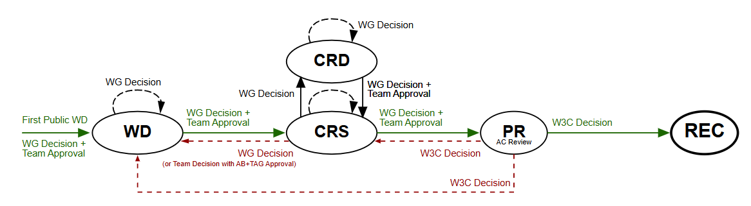
The W3C Recommendation Track
Working Groups create specifications and guidelines to complete the scope of work envisioned by a Working Group's charter.
W3C may end work on a technical report at any time.
Notes:
crs cadidate recommendations
pr proposed recommendation

Slide 80
Process of ODRL2.2
Use cases and requirements
27 use cases collected from the community
20 different people authored the use cases
38 requirements
Conformance
Conformance was checked through the validation of the 38 requirements
Normalisation process
Validator
Implementations
Universidad Politécnica de Madrid
International Press Telecommunications Council
Thomson Reuters

Slide 81
Final question

Slide 82
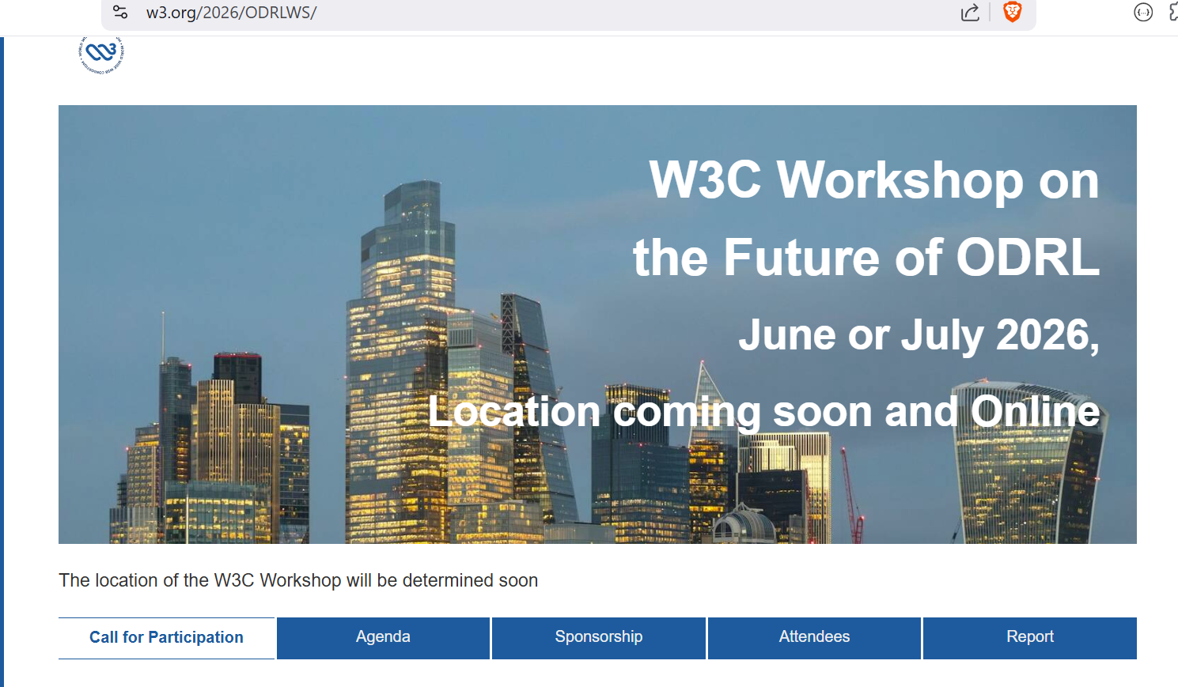

Slide 83
Question 1
Our SHACL shapes are not standard.
Should ODRL 3.0 SHACL shapes be standard?

Slide 84
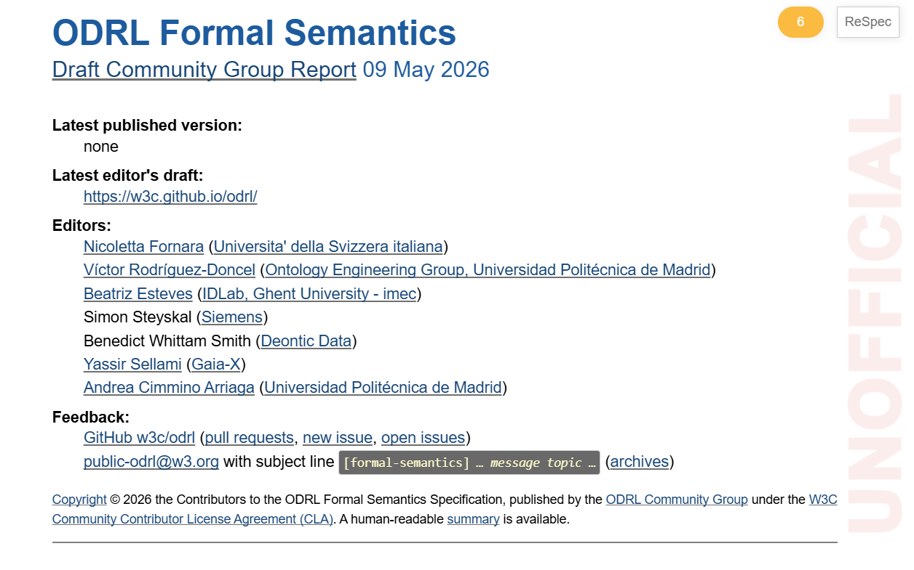
Next session by Nicoletta

Slide 85
Question 2
Formal semantic is a great beginning
How should it be expressed?
HTML + zip with test cases is enough?
Notes:
CURRENTLY HTML WITH MAYBE A ZIP WITH EXAMPLES

